Slide 1


María Rodríguez
19/09/2024

Slide 2

Outline
Executive Summary
Introduction
Methodology
Results
Conclusion
Appendix

Slide 3
Executive Summary
Summary of all results
- Exploratory data analysis results
- Screenshots from interactive analysis
- Predictive analytics results
Summary of methodologies
- Data collection through API
- Data collection using web scraping
- Data wrangling
- Exploratory data analysis with SQL
- Exploratory data analysis using data visualization
- Interactive visual analytics with Folium
- Machine Learning prediction

Slide 4
Introduction
Project background and context
While other providers rocket launch cost upward of 165 million dollars each, Falcon 9 advertises their cost in an average of 62 million dollars, thanks in a big part due to Space X can reuse the first stage. In the other hand, to make this happen the first stage should land successfully. If we can determine if the first stage will land, we can determine the cost of a launch and with this information an alternate company could bid against Space X for a rocket launch.
The goal of this project is to create a Machine Learning pipeline to predict if the first stage will land successfully, this way we can predict estimate cost of a successful launch.
Problems you want to find answers
Identify factors which determine the successfully land of the rocket.
Interaction amongst various features that determine the success rate of a successful landing.
Operating conditions required to ensure a successful landing program.
4

Slide 5

Section 1

Slide 6
Methodology
Executive Summary
Data collection methodology:
Data was collected using SpaceX Rest API and web scraping from Wikipedia.
Perform data wrangling
One-hot encoding was applied to categorical features.
Perform exploratory data analysis (EDA) using visualization and SQL
Perform interactive visual analytics using Folium and Plotly Dash
Perform predictive analysis using classification models
How to build, tune, evaluate classification models.

Slide 7
Data Collection
Data collection is the process of collecting and evaluating information or data from multiple sources to find answers to research problems.
In this dataset this process was made using REST API and web scrapping from Wikipedia.
REST API: Started using get request method. Once information was obtained, response content was decoded as Json and converted into a pandas data frame using json_normalize(). After that, data was cleaned, looked for missing values and corrected if needed.
Web scraping: BeautifulSoup was used to extract launch records as HTML table, parse and convert it to a pandas data frame for an exhaustive analysis.

Slide 8
Data Collection – SpaceX API
Completed notebook:
SpaceX data collection API
Place your flowchart of SpaceX API calls here
get request using API for SpaceX data
json_normalize and pandas to convert json result into a dataframe
Data cleaning and correcting missing values

Slide 9
Data Collection - Scraping
Place your flowchart of web scraping here
Request data from Falcon 9 launch from Wikipedia url
Create a BeautifulSoup from HTML response
Extract column names from HTML header
Completed notebook:
SpaceX data collection using webscraping

Slide 10
Data Wrangling
Data wrangling: is the process of transforming and mapping data from aw into another format with the intent of making it more appropriate and valuable for a variety of purposes such as an easy access and Exploratory Data Analysis (EDA).
Process: First, calculate number of launches for every site and the number and occurrence of mission outcome per orbit type.
Create a landing outcome label from outcome column to make it easier for further analysis, visualization and Machine Learning process. Last but not least, export the result to a CSV file.
You need to present your data wrangling process using key phrases and flowcharts
Add the GitHub URL of your completed data wrangling related notebooks, as an external reference and peer-review purpose
Data wrangling, sometimes referred to as data munging,
Completed notebook: SpaceX data wrangling process

Slide 11
EDA with Data Visualization
First a scatter graph show us the relationship between for the following attributes:
Payload vs Flight number.
Flight number vs Launch site.
Payload vs Launch site.
Flight number vs Orbit type.
Payload vs Orbit type.
Scatterplots help showing attributes’ dependency on each other. It’s simple to see factors affecting the most to the success of the landing outcomes.

Slide 12

EDA with Data Visualization
After analyze the information from scatter plot and visualize possible relationships, more visualization tools are needed for further analysis, such as bar and line plots graphs.
Bar graphs are useful to see relationships between attributes, in our case is used to determine which orbit have the highest probability of success.
Line graphs are used to show trends of the attribute over time.
Feature Engineering will help to predict success by creating dummy variables to categorical columns.
Completed notebook: SpaceX EDA with data visualization

Slide 13
EDA with SQL
We performed different queries using SQL to understand better information obtained, e.g.:
Displaying:
Names of launch sites.
Total payload mass carried by booster launched by NASA (CRS).
Average payload mass carried by Booster version F9 v1.1.
Listing:
Date when first successful landing outcome in ground pad was achieved.
Names of boosters which have success with payload mass over 4000 and less that 6000.
Total number of successful and failure missions
Completed notebook: SpaceX EDA with SQL

Slide 14
Build an Interactive Map with Folium
An interactive map was created with Folium for better visualize where successful and failed attempts took place and where launch sites are placed.
Latitude and longitude coordinates for each launch site were taken and a circle marker added with the name of it.
Failure attempts were assigned to red color while successful were assigned to green color using MarkerCluster().
To better understand where launch sites are place distance from railways, highways, coastlines and nearby cities were calculated and provided in the interactive map.
Completed notebook: SpaceX Interactive Folium map

Slide 15
Build a Dashboard with Plotly Dash
An interactive dashboard was created using Plotly dash so if information is updated so does the dashboard.
In this dashboard we can find a pie chart with total launches in which we could select an specific location if needed.
A scatter graph is in the dashboard too, which shows the relationship between outcome and payload mass in kilograms, where we can also select between the different booster versions.
Completed dashboard: SpaceX Dashboard

Slide 16
Predictive Analysis (Classification)
Building
· Load dataset into Numpy and Pandas.
· Transform data and split it for training and test datasets.
· Review performance of each type of ML to decide which one to use.
· Set parameters and algorithms to GridSearch and fit into the dataset.
Evaluating
Review accuracy for each model.
Get tuned hyperparameters for each type of algorithms.
Plot a confusión matrix.
Improving
Use Feature Engineering and algorithm tuning.
Select
Model with the best accuracy score is the best performing model to be used.
Completed predictive analysis: SpaceX Predictive Analysis

Slide 17
Results
Exploratory data analysis results
Interactive analytics demo in screenshots
Predictive analysis results

Slide 18

Section 2

Slide 19
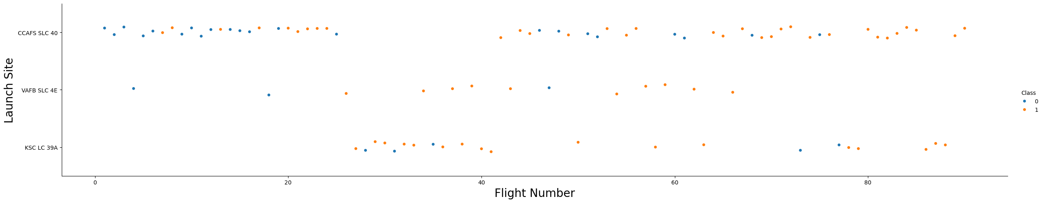
Flight Number vs. Launch Site
As we can see below, there are more launches from CCAPS and less from VAFB but the amount of successful launches are higher in the second one and as the flight number increases, the first stage is more likely to land successfully.

Slide 20
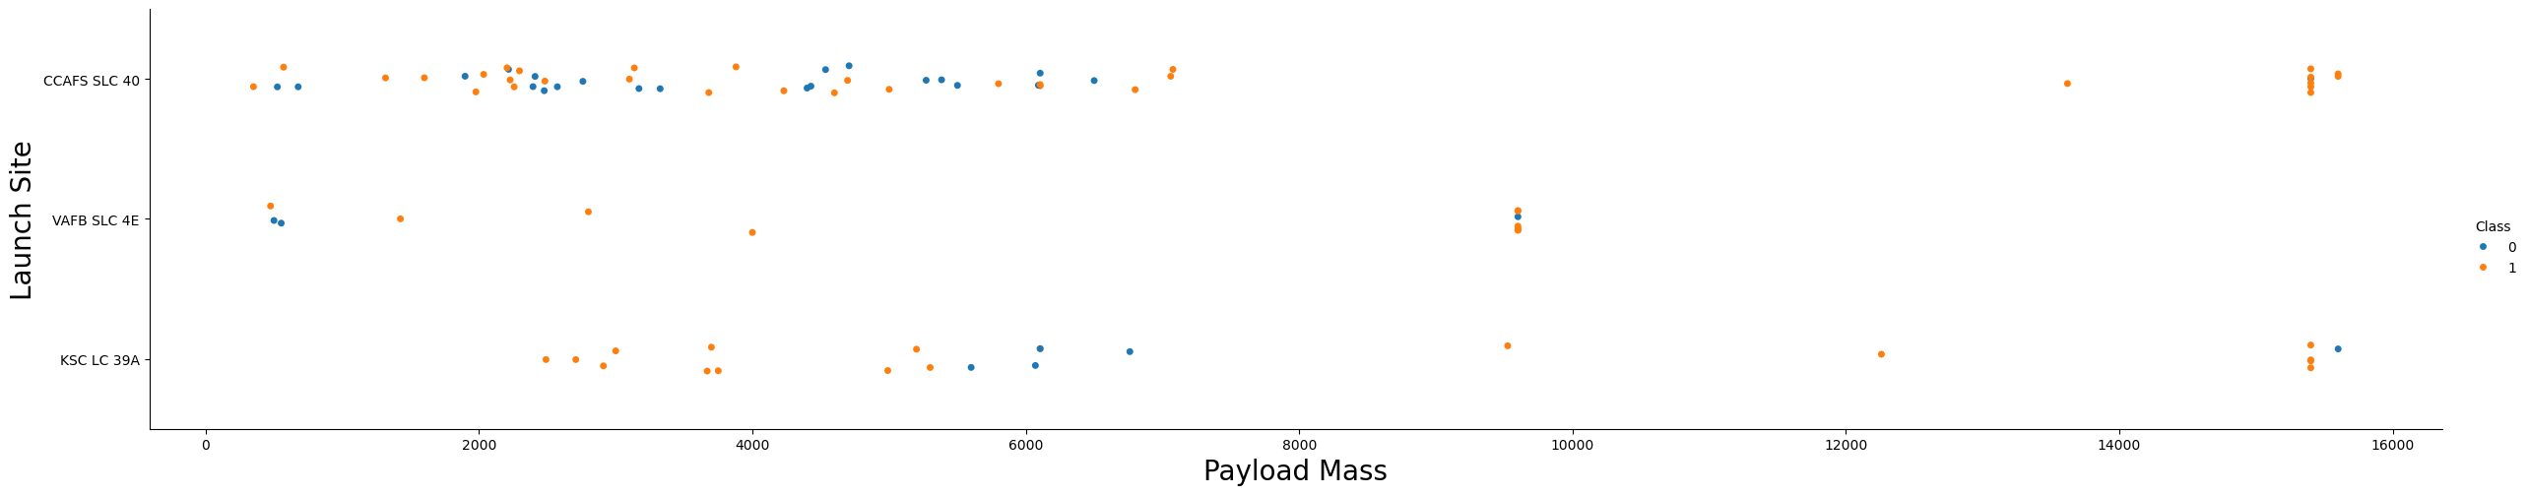
Payload vs. Launch Site
Now if we observe Payload Mass vs. Launch Site scatter point chart you will find for the VAFB-SLC launch site there are no rockets launched for heavy payload mass (greater than 10.000).

Slide 21
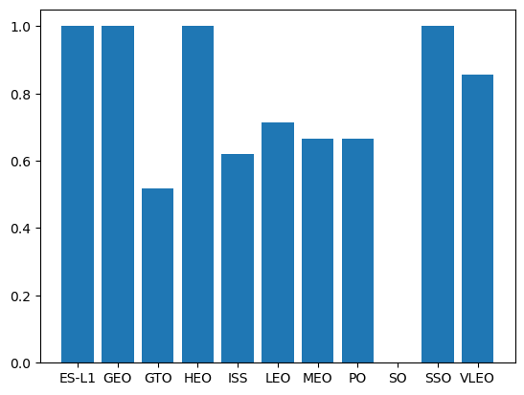

Success Rate vs. Orbit Type
The orbits with higher success rate are ES-L1, GEO, HEO and SSO, the lowest success rate is for SO, meanwhile the rest have and average success rate.

Slide 22
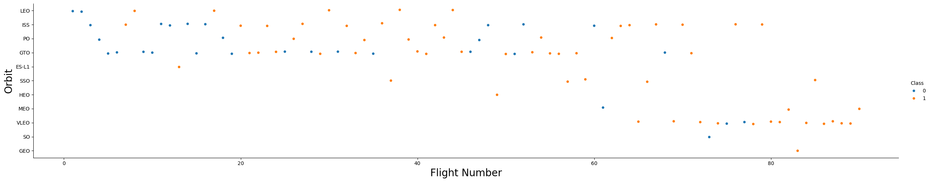
Flight Number vs. Orbit Type
In the LEO orbit, success seems to be related to the number of flights. Conversely, in the GTO orbit, there appears to be no relationship between flight number and success.

Slide 23
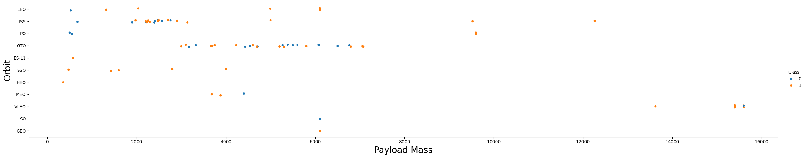
Payload vs. Orbit Type
With heavy payloads the successful landing or positive landing rate are more for Polar, LEO and ISS.
However, for GTO, it's difficult to distinguish between successful and unsuccessful landings as both outcomes are present.

Slide 24
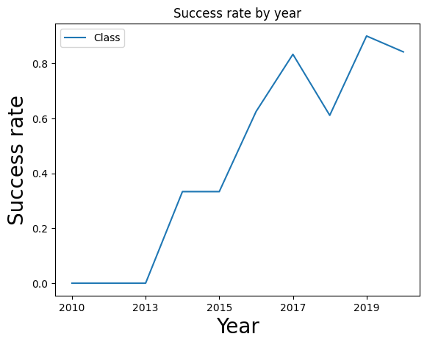
Launch Success Yearly Trend
Success rate since 2013 kept increasing till 2020.

Slide 25
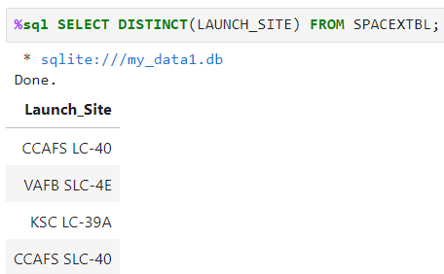
All Launch Site Names
Using SQL we can find the unique names from launch sites as showed below:
With SELECT DISTINCT sql returns unique names from variable ‘Launch site’ and FROM we are selecting ‘Spacextbl’ which is the table where information is contained.

Slide 26
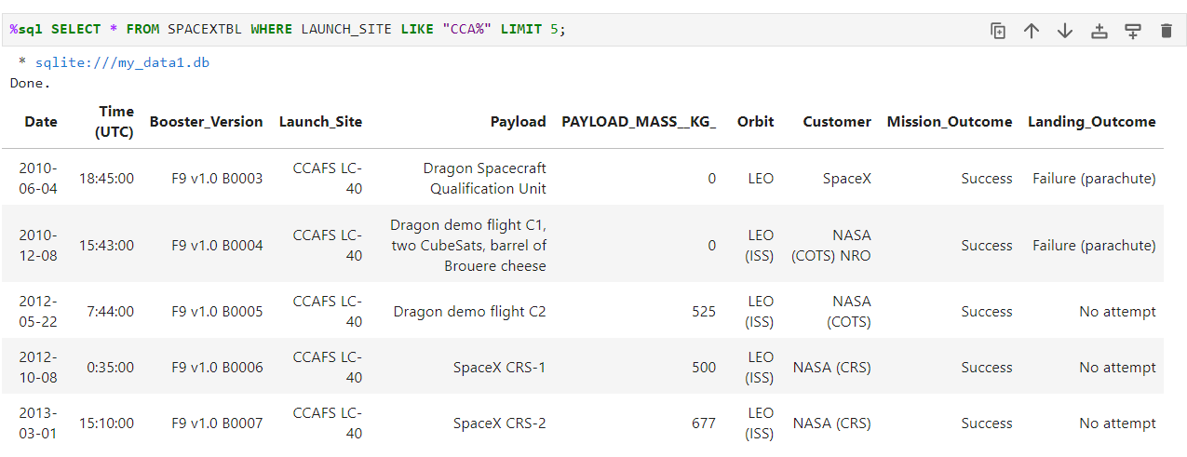
Launch Site Names Begin with 'CCA'
If we want to select 5 records where launch sites begin with ‘CCA’ the command LIKE is used with % for missing values and LIMIT with the number of results wanted.

Slide 27
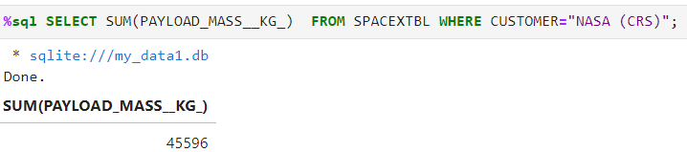
Total Payload Mass
If we want to calculate the total payload carried by boosters from NASA, we need the function SUM which sums the column PAYLOAD MASS KG and with the WHERE clause we filter results for NASA (CRS)

Slide 28
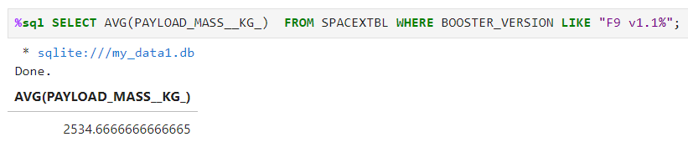
Average Payload Mass by F9 v1.1
To calculate the average payload mass carried by booster version F9 v1.1 we use function AVG which means average after SELECT and filter results for version like with WHERE clause, including LIKE in case some version are written in a different way.

Slide 29
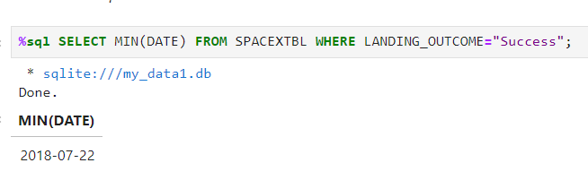
First Successful Ground Landing Date
First successful landing on ground pad was on July 22th in 2018 according with SQL, to get this information we SELECT the older date with MIN(DATE) filtering with WHERE clause the LANDING OUTCOME in which dates are

Slide 30
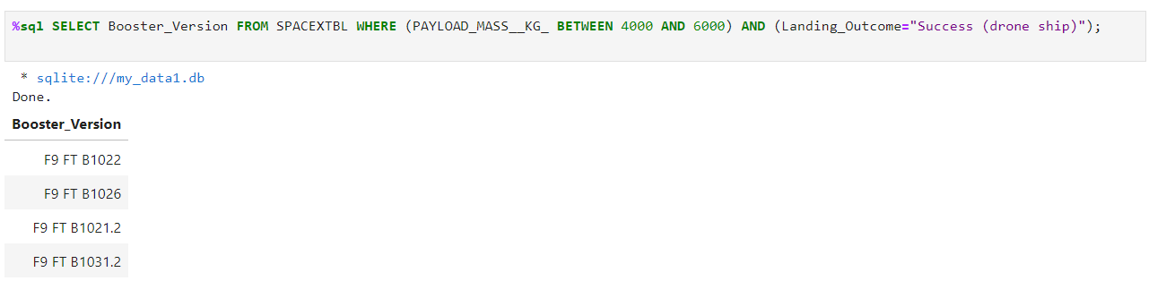
Successful Drone Ship Landing with Payload between 4000 and 6000
To list the names of boosters which have successfully landed on drone ship and had payload mass greater than 4000 but less than 6000 we SELECT column called Booster Version FROM table called SPACEXTBL filtering with the WHERE clause by Payload mass AND Success (drone ship)

Slide 31
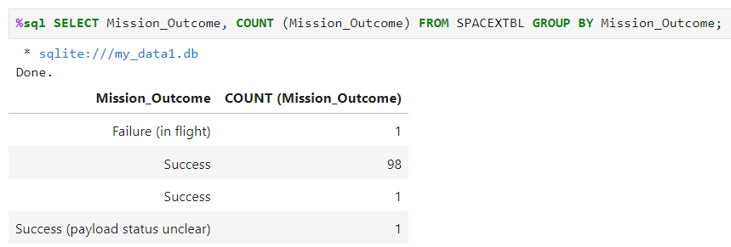
Total Number of Successful and Failure Mission Outcomes
If we want to calculate the total number of successful and failure mission outcomes we need to SELECT column Mission Outcome, COUNT the quantity of that Mission Outcome and GROUP BY the different Mission Outcome we found in our table.

Slide 32
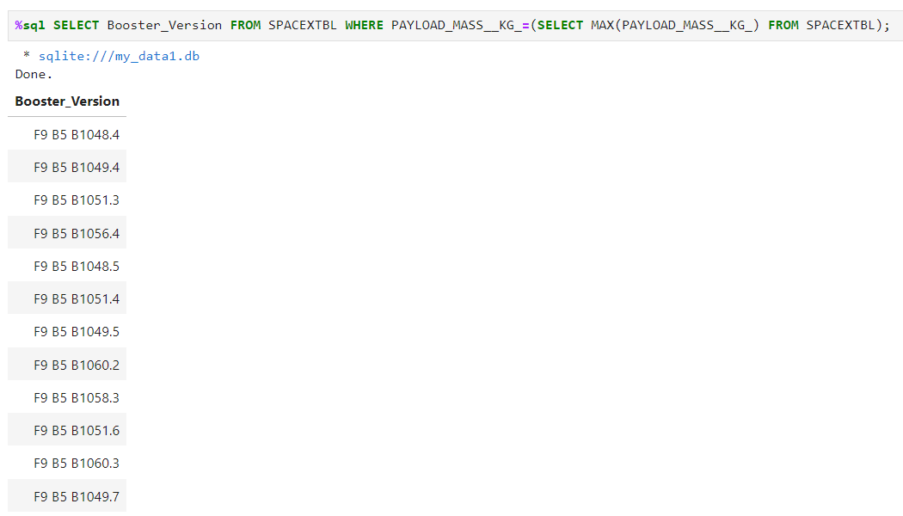
Boosters Carried Maximum Payload
Here are the list of the names of the booster which have carried the maximum payload mass, to get this information we need a subquery looking for maximum payload mass.

Slide 33
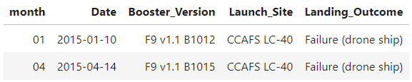
2015 Launch Records
The failed landing outcomes in drone ship, their booster versions, and launch site names for in year 2015 are listed below:

Slide 34
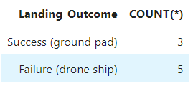
Rank Landing Outcomes Between 2010-06-04 and 2017-03-20
Ranking shows Failure (drone ship) or Success (ground pad) in descending order:

Slide 35

Section 3

Slide 36
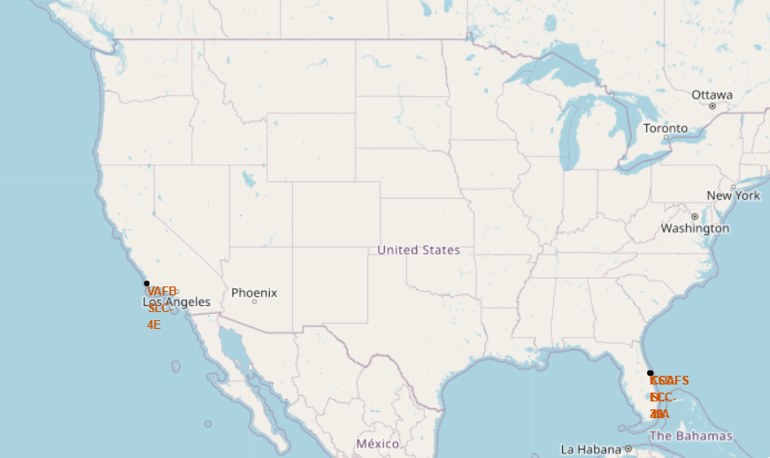
Launch sites for SpaceX in USA
As we can see launch sites are place close to the coast within USA.

Slide 37
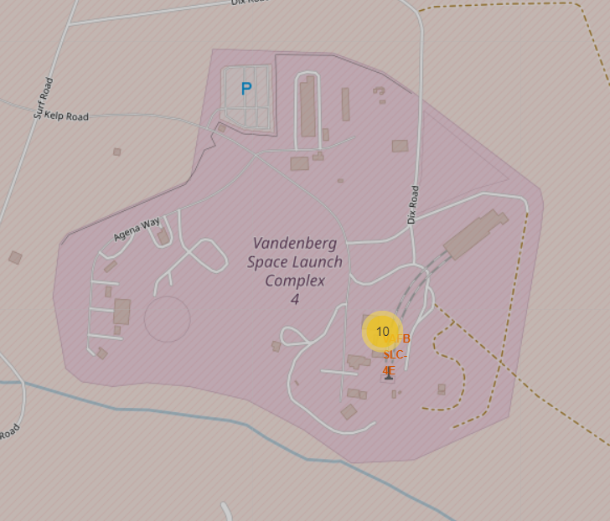
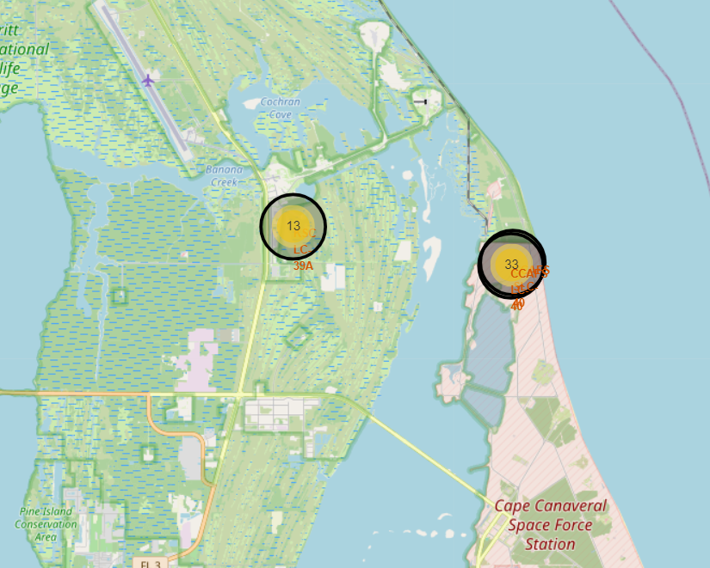
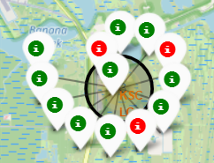
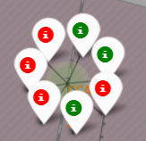
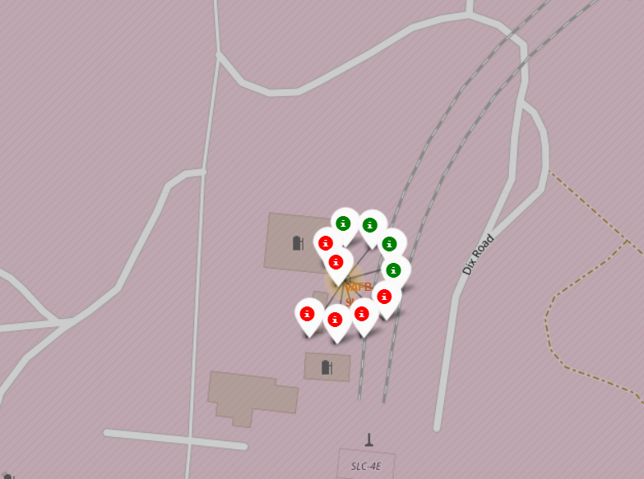
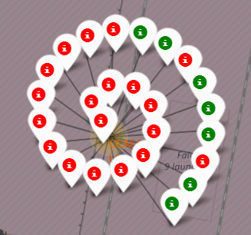
Launch sites with color labels
Green markers shows successful launches while red ones shows failed ones.
California
Florida

Slide 38
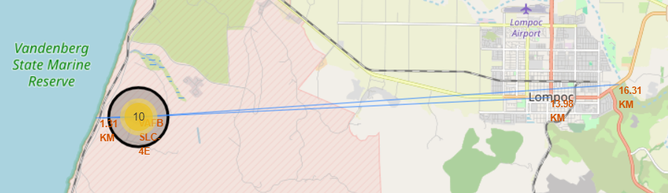
Launch Site distance to key places
Launch sites are close to railways as transport is cheaper an easy by train in case they need materials from other states they are close to highways too as is better for people who work there and materials which can't be transported by train. ·
Launch sites are close to coastline for safety reasons but aren't close to cities to avoid risks.

Slide 39

Section 4

Slide 40
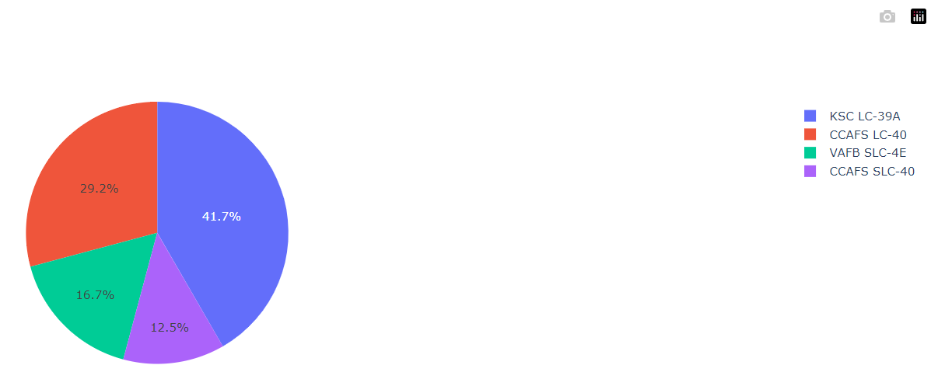
Pie chart: Success by each launch site
Most successful launches are from KSC LC 39A

Slide 41
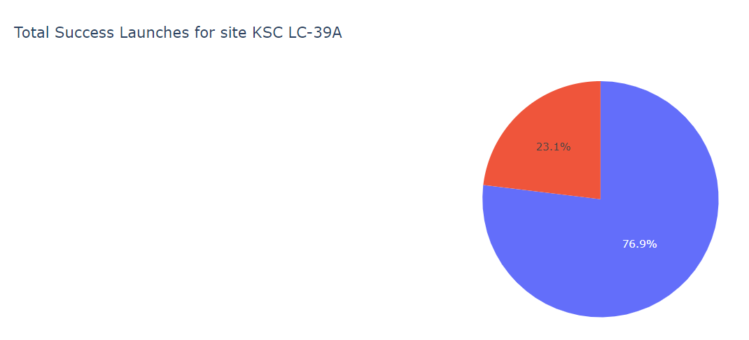
Pie chart from KSC LC 39A
KSC LC 39A has the higher successful rate with a 76,9% of success versus 23,1% of failed attempts.

Slide 42
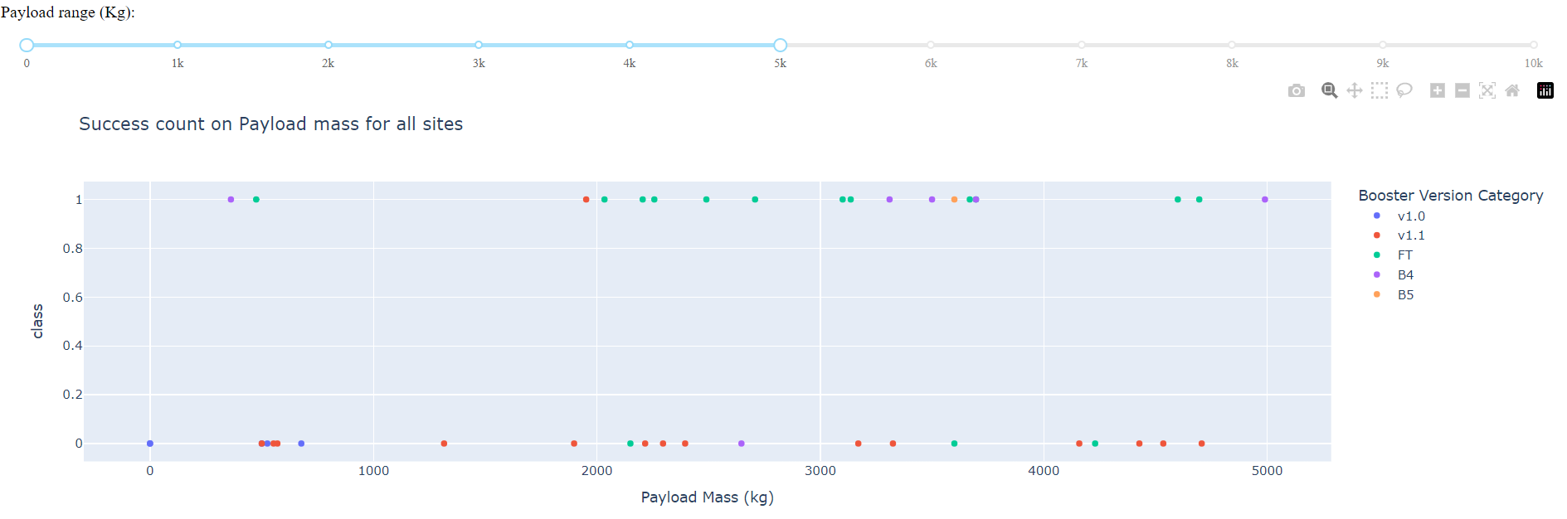
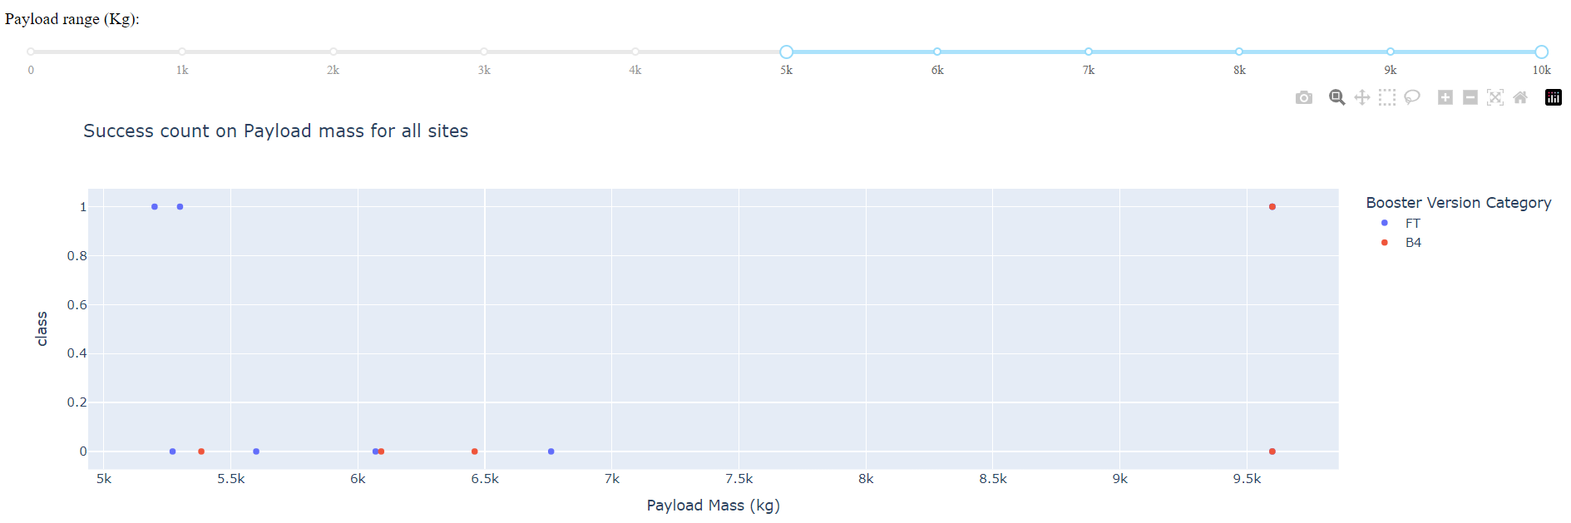
Payload vs. Launch Outcome scatter plot for all sites
Success rates for payloads over 5000kg are lower than for smaller payloads.

Slide 43

Section 5

Slide 44
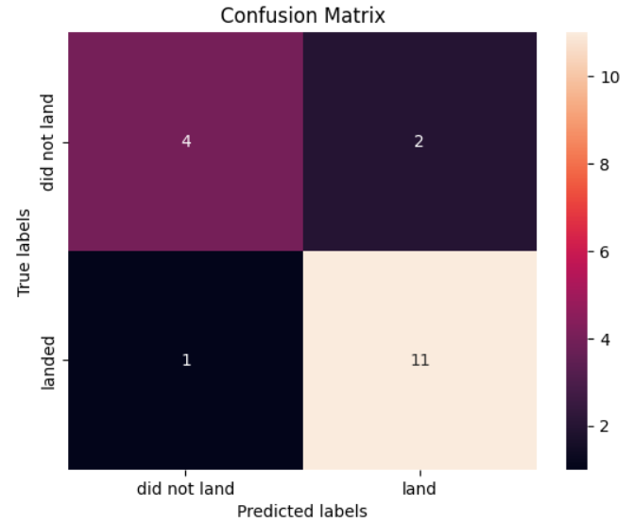
Confusion Matrix
Confusion matrix for the decision tree classifier shows that the classifier can distinguish between the different classes better than other methods.

Slide 45
Conclusions
Launch success rate started to increase in 2013 till 2020.
Orbits ES-L1, GEO, HEO, SSO, VLEO had the most success rate.
KSC LC-39A had the most successful launches of any sites.
The Decision tree classifier is the best machine learning algorithm in this case.

Slide 46


